Slide 1


Slide 2
GOALS SETTING AND ACHIEVEMENT
OUR TARGET
What it means to set Goals
Short goals and the big dream
Challenges of pursing a goal
Self-determination and tenacity
Failure and success
Pathway to success

Slide 3

Our motivation
Do you see a man skilled in his work?
He will stand in the presence of kings; He will not stand in the presence of unknown (Prov. 22:29)

Slide 4

Without Dreams, goals are mere illusion
The Big Question is, do you have a dream? if yes, how big is your dream
Think Big,
Plan Big
You can Start Small
27/07/2024
By David Okorochukwu

Slide 5
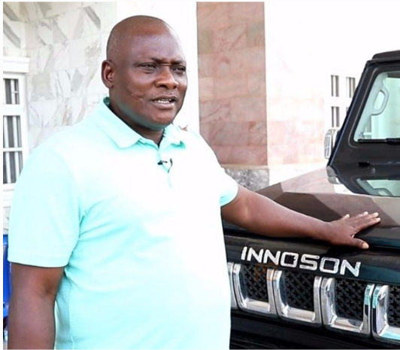
Learn from the Billionaires
Innoson Started from
Apprenticeship

Slide 6

Learn from the Billionaires

Slide 7

The bigger problem is that Most young people don’t even have dreams

Slide 8


Keys to having a big Dream
Right Knowledge
Vision
Guardianship
Write the dream & vision down
Set A Goal to meat Your dream

Slide 9
Practical Approach to having a big Dream
Right Knowledge
Getting the right knowledge is one the key major of conceiving an idea or dream.
Appreciate anything that will expose you to knowledge. We are slaves to what we don’t know.
People waste their lives and time because of lack of knowledge.
If you that 50% of global wealth are hidden inside our bushes and greater more inside the earth crust, you will do something.

Slide 10
Practical Approach to having a big Dream
Vision
You must learn to think
Vision is the ability to see the fact and the possibility of your thought
For Instance, you have a dream to have a car plant, Until you begin to see your car plant in your mind, your motivation and drive will not last long.
The different between a failure and an achiever is that the later converted his thought to a clearer picture and reality in his mind, and the excitement of what he saw helped him not to give up.

Slide 11
Practical Approach to having a big Dream
Guardianship
As part of getting Knowledge, you must look for a guardian who knows more than you to guild you make the right steps.
Our society recorded drastic decline in productivity when we deliberately started abusing mentorship and apprenticeship.
No reasonable person will dive into the ocean in search for resources without being trained and guided.

Slide 12

Practical Approach to having a big Dream
Write the dream & vision down
Because its going to be a Long journey please write the dream down.
Distractions and engagement may deviate your mind from the dream, but that which is written is always preserved
Some dreams are transferable, imagine they were not written down in the point of conception

Slide 13

What Dream is not
Dream is not a wish
It is not a mere assumption
I just want to be rich
I just want to get married
I just want to be a graduate
The worst is not having anything

Slide 14


If You must have dream, please let it be big
Your Dream should belong to Any of the following:
Economic influence
Social Influence
Technology and Scientific Influence
Spiritual Influence (for pastors)

Slide 15

What Dream is
Tangible thing I must achieve
I want to represent my country in Olympic
I want to get to the position to influence the educational system of my country
I want to be an economic and financial constant to companies and even nations
I want to build a business that will employ thousands of people
I want to have the designer factory etc

Slide 16
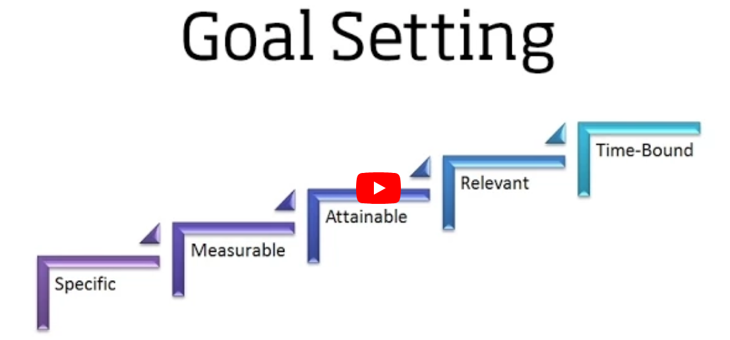
Goals are practical steps, plans and action you are walking towards achieving your dream

Slide 17
Goal is the ladder to climb to the dream
No life experience is more frustrating than having a dream with no set goals to achieving them

Slide 18
Challenges associated with Dreams and Goals
Because they are not tangible, some concluded them to be mere illusion
Human beings are drawn to their natural reality hence, run after their present accessible and reachable.
It is very difficult to think about the future you haven’t seen let alone planning for it.

Slide 19
Challenges associated with Dreams and Goals
Lack of Opportunity to work towards your goal
Constraint to develop by acquiring more knowledge and skills
360-degree Distractions
Impatient

Slide 20
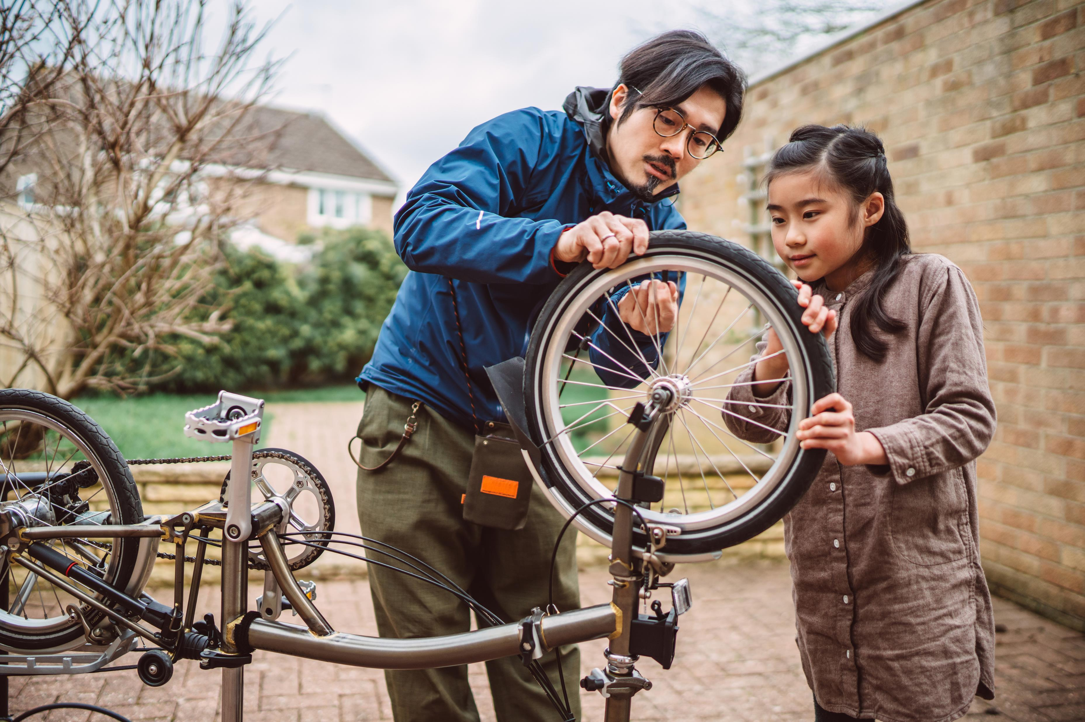
I need help please,
Let's Fix Things
Start Thinking today
Get rid of junk thoughts
Get rid of distractions
Make decisions
Think of getting a coach or guardians

Slide 21

I need help please,
Ask Yourself this questions
What do I want to achieve in this life?
What steps should I follow to achieve this dream
Who and what can help me towards this goal
What is the first step I need to take

Slide 22

Question and Answer time

